Slide 1
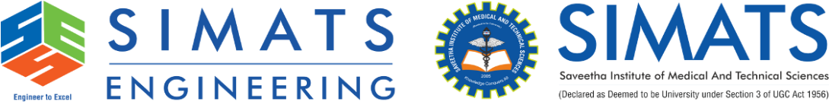
Technical Presentation
DSA0307- NATURAL LANGUAGE PROCESSING
PRESENTED BY:
Charandeep.N.C
192472196
GUDIED BY:
Dr.K.Anbazhagan

Slide 2


Introduction to Derivational Morphology
What is Derivational Morphology?
Derivational morphology is the process of creating new words by adding prefixes or suffixes to a root word. The new word often has a different meaning or belongs to a different grammatical category.
Key Points
Forms new words from existing words.
Uses prefixes and suffixes.
Can change the meaning of a word.
Can change the part of speech (noun, verb, adjective, etc.).
Plays an important role in Natural Language Processing (NLP).
Example:
Root Word | Derived Word | Type
Happy | Unhappy | Prefix
Teach | Teacher | Suffix
Nation | National | Suffix
Use | Reuse | Prefix

Slide 3
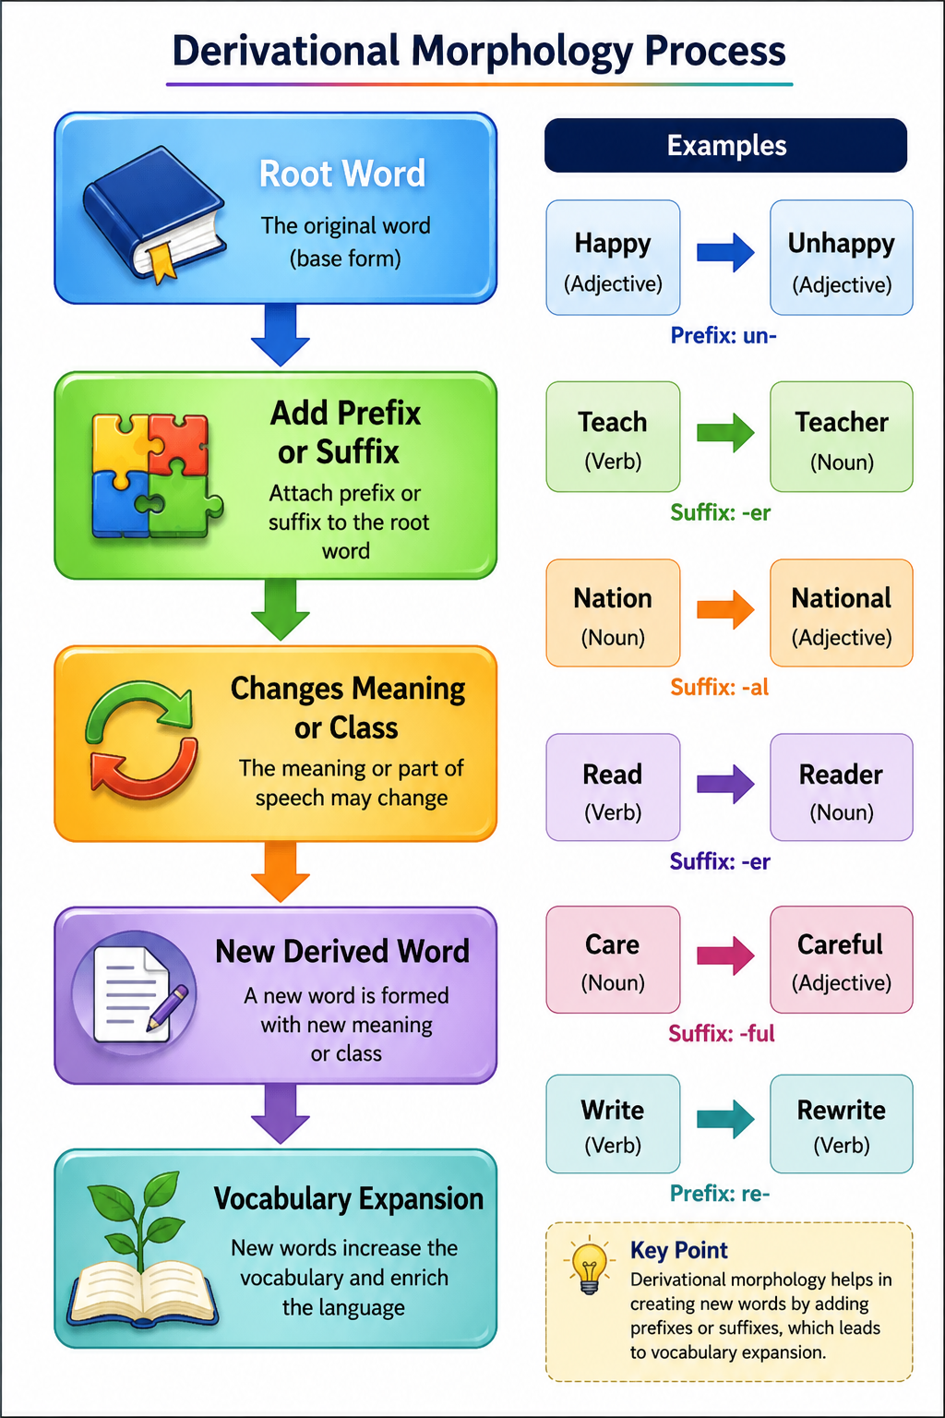
Word Formation Process

Slide 4
Types of Derivational Affixes
1. Prefixes (Added Before the Root)
Prefix | Meaning | Example
Un- | Not | Happy → Unhappy
Re- | Again | Write → Rewrite
Dis- | Opposite | Agree → Disagree
Pre- | Before | View → Preview
EX:
Prefix + Root + Suffix
Un + Happy = Unhappy
Teach + er = Teacher
Kind + ness = Kindness
2. Suffixes (Added After the Root)
Suffix | Changes Into | Example
-er | Noun | Teach → Teacher
-ness | Noun | Kind → Kindness
-ful | Adjective | Hope → Hopeful
-ly | Adverb | Quick → Quickly

Slide 5
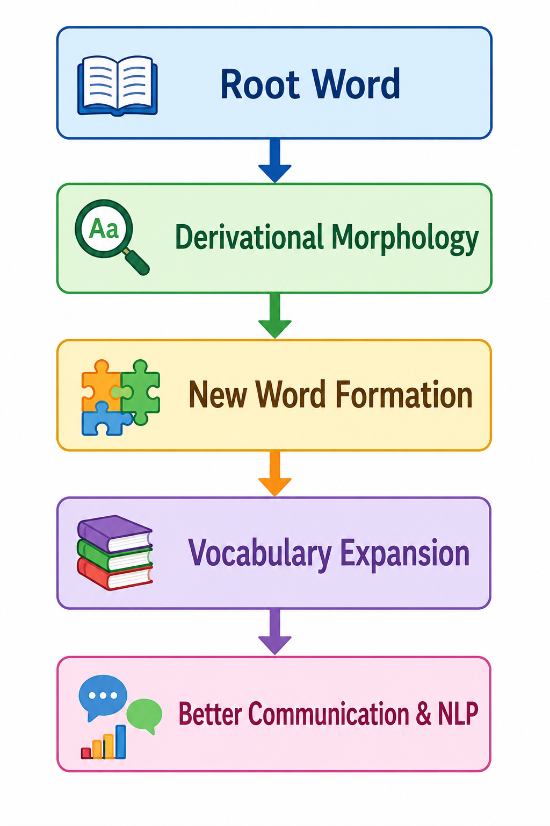
Vocabulary Expansion
What is Vocabulary Expansion?
Vocabulary Expansion is the process of increasing the number of words in a language by creating new words from existing root words. Derivational morphology is one of the most common methods used for vocabulary expansion.
Example:
Root Word | Expanded Vocabulary
Act | Action, Active, Activity, Actor, Activate
Read | Reader, Readable, Reading, Reread
Write | Writer, Rewrite, Writable, Writing

Slide 6
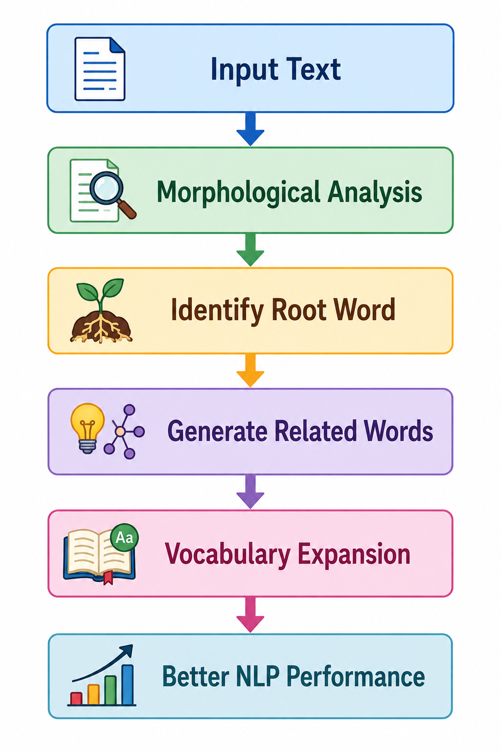
Importance of Vocabulary Expansion in NLP
How Vocabulary Expansion Helps NLP
Applications
Search Engines
Machine Translation
Chatbots & Virtual Assistants
Spell Checking
Text Summarization
Sentiment Analysis
Information Retrieval
Benefits
Improves text understanding.
Recognizes different forms of the same word.
Increases search accuracy.
Enhances communication between humans and computers.

Slide 7
Advantages, Challenges & Conclusion
Advantages
Expands vocabulary quickly.
Improves communication and language learning.
Supports accurate text analysis.
Helps NLP systems understand word relationships.
Increases the performance of AI language models.
Challenges
Irregular word formation.
Words with multiple meanings.
Language-specific grammatical rules.
Complex morphological structures.
Conclusion
Derivational Morphology creates new words by adding prefixes and suffixes.
These newly formed words contribute to Vocabulary Expansion.
Vocabulary expansion enriches language and improves NLP applications such as search engines, machine translation, and chatbots.
Together, they make language processing more accurate and efficient.

